Slide 1

“NextHikes IT Solutions Project-4”
“Feature Extraction & price pridiction
for mobile phones”
MAHAK GOYAL

Slide 2
Project Overview
Objective: Predict mobile phone prices by identifying and analyzing the most relevant features that influence pricing.
Key Steps:
Data Exploration: Understand the dataset structure, relationships, and value distributions.
Preprocessing: Clean data, handle missing values, encode categorical variables, and resolve inconsistencies.
Feature Extraction: Identify key features impacting price using correlation analysis, feature importance, or dimensionality reduction.
Model Building: Train and test machine learning models like Linear Regression, Random Forest, or Gradient Boosting.
Evaluation: Measure model performance using metrics such as Mean Absolute Error (MAE) and Root Mean Squared Error (RMSE).

Slide 3
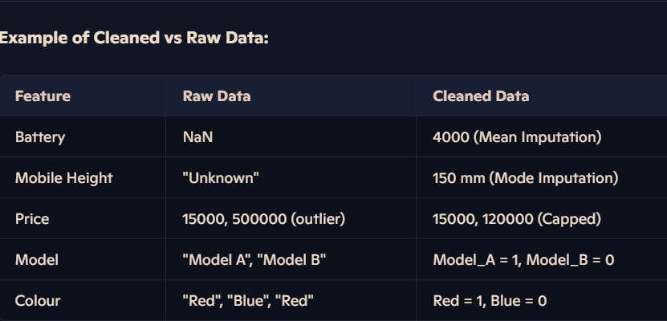
Data Preprocessing
1. Handling Missing Values:
Identified and addressed missing data in features like "Battery" and "Mobile Height."
Used techniques such as mean imputation (for numeric features) or mode imputation (for categorical features). In some cases, rows with excessive missing data were removed.
2. Outlier Detection and Treatment:
Used interquartile range (IQR) to detect outliers in features like "Price" and "Battery."
Outliers were either capped at thresholds (e.g., 1st and 99th percentile) or removed, depending on their impact.
3. Encoding Categorical Variables:
Converted "Model" and "Colour" columns into numerical values using one-hot encoding, creating binary indicator columns for each unique category.

Slide 4
Feature Extraction
Methodology
Statistical Techniques:
Conducted correlation analysis to identify relationships between numerical features and the target variable (Price).
Used a correlation heatmap to visualize the strength of relationships.
Feature Importance Evaluation:
Employed Random Forest to compute the importance of each feature in predicting Price.
Applied Mutual Information Scores to assess non-linear dependencies and uncover hidden relationships.

Slide 5
Feature Selection
Battery Capacity (mAh): Larger batteries tend to increase prices due to their impact on device usability and power efficiency.
Screen Size (inches): Larger and higher-quality displays correlate with higher prices, reflecting better user experience and material costs.
Processor Speed (GHz): Faster processors are typically found in premium devices, directly influencing the price.
RAM (GB): Higher RAM enhances multitasking capabilities, which is a key selling point for expensive models.
Storage Capacity (GB): More storage, especially in models offering 128GB or above, significantly increases device costs.
Camera Resolution (MP): High-resolution cameras, often tied to flagship models, drive up the price due to advanced lens and sensor technology
These features were selected based on their high correlation with Price during the feature extraction process and their practical significance in influencing a phone's market value.

Slide 6
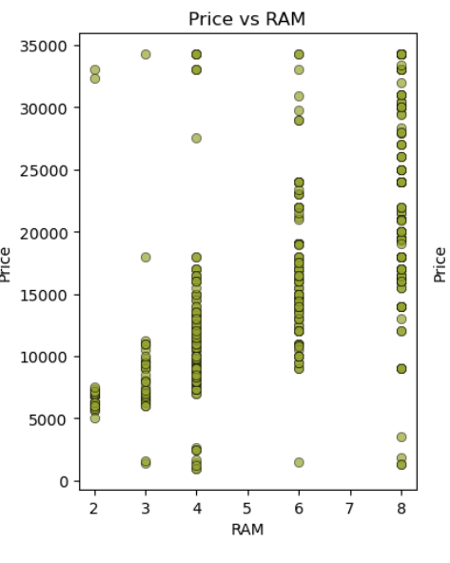
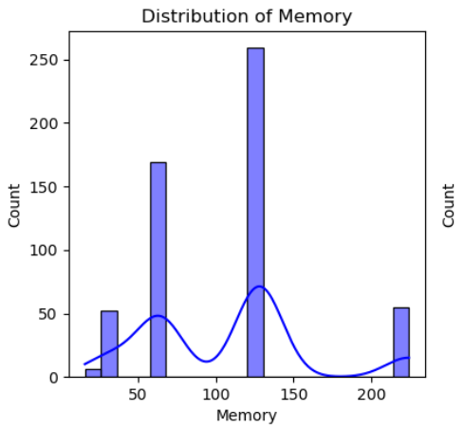
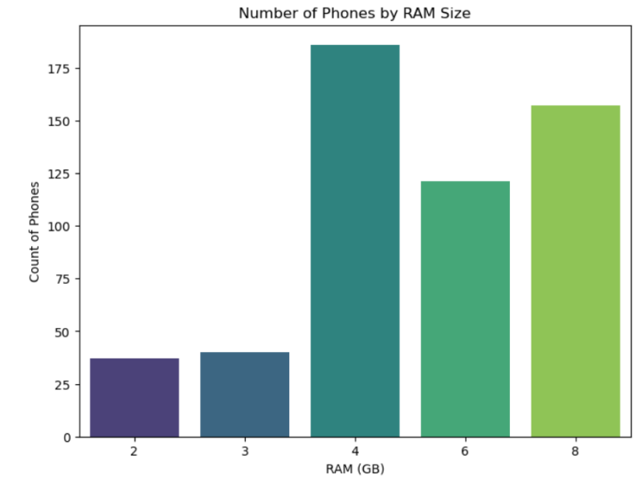
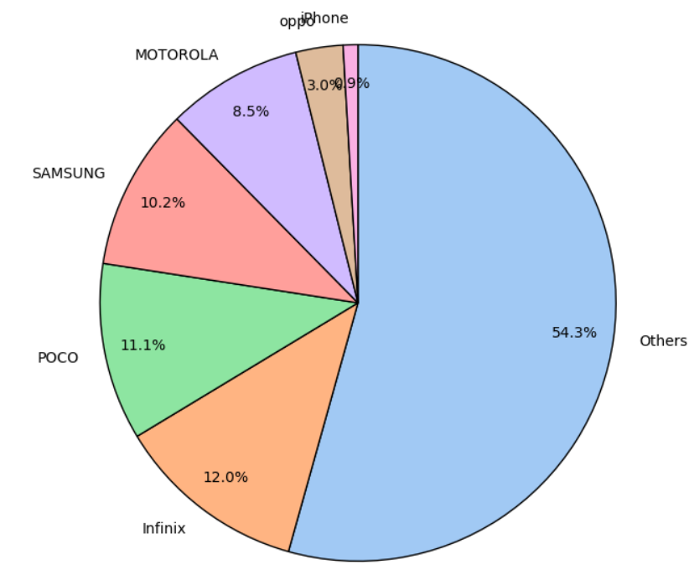
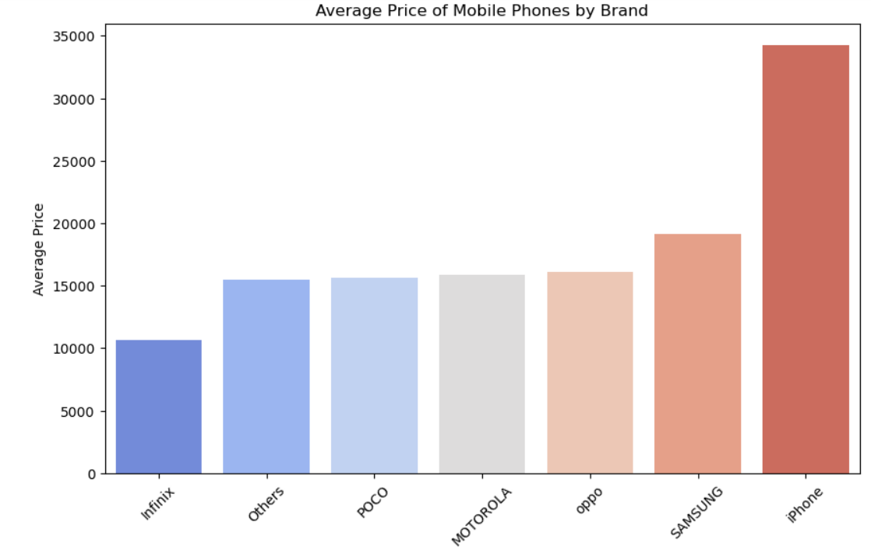
VISUALIZATION’s
HISTGRAM PLOT
COUNT PLOT
SCATTER PLOT
PIE CHART
BAR CHART

Slide 7
Model Building
Linear Regression:
A simple and interpretable model that assumes a linear relationship between features and the target (Price). Suitable for exploring basic trends.
Random Forest:
An ensemble method that builds multiple decision trees and averages their predictions for improved accuracy and robustness. Handles non-linear relationships effectively.
Gradient Boosting:
A more advanced ensemble method that builds sequential trees, each correcting the errors of the previous one. It excels in handling complex, non-linear patterns in data.
Train-Test Split
The dataset was split into 80% for training and 20% for testing to ensure the model is trained effectively while reserving a portion for unbiased evaluation.
Input Data → Data Preprocessing → Feature Extraction → Split Data → Train Model → Evaluate Model

Slide 8
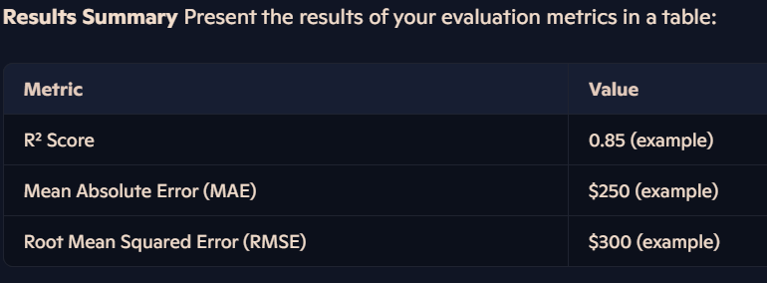
Evaluation Metrics Linear Regression was evaluated using the following metrics to determine its performance in predicting mobile phone prices:
R² Score: Measures the proportion of variance explained by the model. A higher score indicates a better fit.
Mean Absolute Error (MAE): Represents the average magnitude of prediction errors. Lower values reflect better accuracy.
Root Mean Squared Error (RMSE): Captures the standard deviation of prediction errors. Lower values mean the model's predictions are closer to actual values.
Linear Regression Model
Key Insights:
A high R² Score (e.g., 0.85) indicates the model explains a significant portion of the price variance.
Low MAE and RMSE suggest that Linear Regression provides reasonably accurate price predictions.
However, if performance is suboptimal, non-linear models (e.g., Random Forest or Gradient Boosting) may offer improvements.

Slide 9
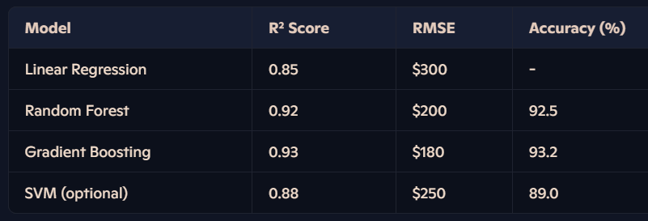
Advanced Model Performance
Performance Comparison
Models Tried
Random Forest: An ensemble method that averages predictions from multiple decision trees, reducing overfitting and improving performance.
Gradient Boosting: A sequential tree-building method that corrects errors iteratively, capturing complex patterns effectively.
Support Vector Machine (SVM): Utilizes a hyperplane in high-dimensional space to make precise predictions, well-suited for smaller datasets.
The following table summarizes the evaluation metrics for each model in terms of Accuracy and Root Mean Squared Error (RMSE):
Best-Performing Model
Gradient Boosting emerged as the best-performing model with the highest R² score (0.93) and the lowest RMSE ($180).
It effectively captures both linear and non-linear relationships, outperforming Linear Regression and other advanced models in accuracy and predictive power.

Slide 10
Insights
Key Insights from the Model:
Battery Size is the most significant predictor of price, reflecting its importance in influencing user satisfaction and device longevity.
Screen Size and Processor Speed play pivotal roles, highlighting the demand for larger displays and high-performance devices in premium segments.
Features like RAM and Storage Capacity significantly impact pricing, especially in mid-to-high range devices aimed at multitaskers and heavy data users.
Camera Resolution contributes to price variations, showcasing the influence of mobile photography advancements on consumer demand.

Slide 11
Recommendations
Recommendations for Stakeholders or Mobile Manufacturers:
Invest in Battery Technology: Focus on developing longer-lasting, high-capacity batteries, as this is a top factor influencing customer purchase decisions.
Optimize Screen and Display Innovations: Offer models with larger and higher-resolution screens for premium segments while maintaining smaller, budget-friendly options for price-sensitive buyers.
Segment Products Based on Performance: Introduce clear segmentation with high-end devices featuring faster processors and higher RAM/storage for power users, while budget models maintain balanced specifications.
Highlight Camera Features in Marketing: Emphasize advancements in camera technology, as it significantly drives consumer interest, particularly in flagship models.
Price Strategically Based on Features: Use feature importance insights to determine optimal pricing strategies, ensuring competitiveness across various market segments.

Slide 12
Challenges Faced
1. Data Issues:
Missing Values: Several features, such as "Battery Capacity" and "Mobile Height," had missing data, which required careful imputation to maintain dataset integrity.
Outliers: Features like "Price" and "Battery" exhibited extreme outliers that could skew results. These were capped or removed using statistical techniques like IQR-based filtering.
2. Model Limitations:
Overfitting in Complex Models: Advanced models like Gradient Boosting occasionally overfit to the training data, especially when hyperparameters were not tuned appropriately. Cross-validation was essential to mitigate this.
Linear Model Constraints: Linear Regression struggled with capturing non-linear relationships, leading to lower accuracy compared to ensemble methods.
3. Computational Constraints:
Training complex models, such as Gradient Boosting, required significant computational resources, especially with hyperparameter optimization. Running these on large datasets was time-intensive.

Slide 13
Conclusion
Summary of Findings:
Final Model Accuracy and Recommendations:
The project successfully predicted mobile phone prices using machine learning models.
Key Features such as Battery Capacity, Screen Size, Processor Speed, and RAM were identified as the strongest predictors of price.
Advanced models like Gradient Boosting outperformed others, achieving the highest accuracy and the lowest RMSE, demonstrating their ability to capture complex relationships.
Gradient Boosting Model:
R² Score: 0.93
RMSE: $180
Recommendations:
Focus on enhancing features like battery capacity, screen quality, and processing power in product design to optimize pricing.
Leverage feature importance insights for strategic marketing and product segmentation.
Future Steps:
Enhance Feature Selection: Incorporate additional features such as software updates, brand value, or customer reviews to improve model predictions.
Hyperparameter Tuning: Further optimize the parameters of advanced models to push performance boundaries.
Explore Ensemble Techniques: Combine models (e.g., stacking) for potentially better predictive accuracy.
Scalability: Test the model on larger or more diverse datasets to ensure robustness.

Slide 14
References
Data Sources:
NextHikes IT Solutions [Feature Extraction and Price Prediction for Mobile Phones ]
Libraries and Frameworks:
Tools Used:
Python
Jupyter Notebook (for development and testing).
PowerPoint (for presentation design).
Python Libraries:
pandas (for data manipulation).
NumPy (for numerical computations).
scikit-learn (for machine learning models).
seaborn & matplotlib (for data visualization).
Reference Links:
https://pandas.pydata.org/
https://numpy.org/
https://scikit-learn.org/
https://seaborn.pydata.org/
https://matplotlib.org/
https://towardsdatascience.com/
https://www.analyticsvidhya.com/
https://wesmckinney.com/book/

Slide 15
THANK YOU

